Slide 1
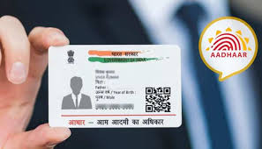
UIDAI HACKATHON
Team Name: TECHNOGIANT
Team ID: 96GOZJ7aYi
Theme 1: Address Update
Problem Statement: Address Formatting Issue

Slide 2

Introduction
In the last 10 years, UIDAI has enabled 130+ cr residents of India, spread from Turtuk in the north to Indira Point in the south, Ghuar Mota in the west to Kibithu in the east with digital identity. It has supported inclusiveness by enabling residents to interface with various Digital India initiatives. Residents can prove their identity with demographics, biometrics, OTP or a combination of them.
To facilitate enrolment to the aadhaar platform and for the subsequent update of Aadhar during life events, UIDAI has established a large number of enrolment centers across the country. Also, it has established a self-service online platform to interface and undertake update of demographics data. Even with the abundance of touchpoints, UIDAI believes that there is a scope to improve the experience around the online address update process through the adaptation of technology.
UIDAI is calling for innovative ideas and solutions, backed up by demonstrable code from young minds to enhance the address update experience of a resident. Show your problem-solving skills and understanding on open-source technologies to build an online address update process covering the following use cases.

Slide 3

Problem Statement
You have to devise an innovative solution to identify repetitive content (like Delhi in the instant use case) and merge it in a manner that the overall address remains intact and usable. The solution must comply with the following:-
1. Essential fields like District and State can be merged into a single entity.
2. If the repetitive text is a subpart of a field, then merger should be avoided. For example, ‘Purani Delhi’ as locality and ‘Delhi’ as State can’t be merged.
3. An API is to be developed which will take the address in its raw form as input and optimized/formatted response should be the output. No user interface would be required.
4. Bonus credit would be given to the team who can also consider the address in the local language and optimize the same.
5. You can use any open-source technologies to demonstrate the solution.

Slide 4

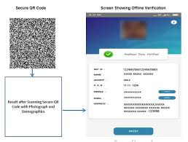

Solution
Tokenization- Natural Language Processing
Word Semantic
With the help of NLP, we have merged the word w.r.t its similarity index and resulting into short and simple arrangement of address.

Slide 5

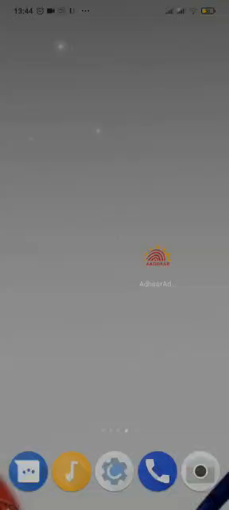

Video Output

Slide 6

Technogiant Stage UID: 999937238743
Darshan Patil
Khushi Mishra
Vaishnavi Deulkar
Gopal Sakarkar
Artificial Intelligence Department,
G.H Raisoni College of Engineering, Nagpur, M.H, India [440016]

